Slide 1
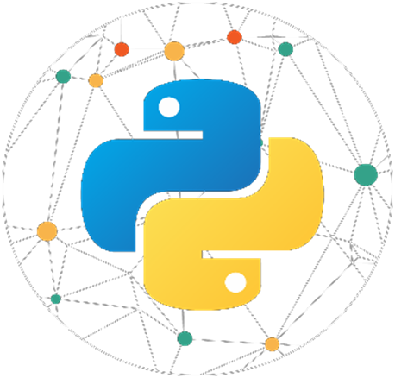
1 . 1 P Y T H O N 1 0 1
S r i r a m - I T E x p e r t
Y o u t u b e C h a n n e l : I n t e l l e c t S r i r a m

Slide 2
Programming Languages Overview

Slide 3
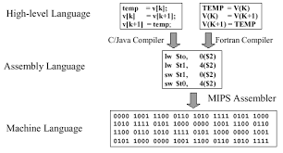
Programming Languages
Python 101
A programming language is a formal language which comprises a set of instructions used to produce various kinds of output by a computer. Computer programs are commonly known as Software.
Programming languages are used in computer programming to create programs that implement specific algorithms.
The instructions of program tells the computer what to do next and these instructions are two types of programming languages namely:-
Low Level Language
Machine Language
Assembly Language
High Level Language

Slide 4
Low Level Language
Python 101
Machine Language and Assembly Language are referred to as Low Level Language
Machine Language
A computer is an electronic machine which can understand any instruction written in binary form. i.e., 0’s and 1’s. The lowest-level programming language, machine languages are the only languages understand by computers.
While easily understood by computers, machine languages are almost impossible for humans to use because they consist entirely of numbers.
Every CPU has its own unique machine language. Programs must be rewritten or recompiled, therefore, to run on different types of computers.

Slide 5
Low Level Language
Python 101
Assembly Language
An assembly language contains the same instructions as a machine language, but the instructions and variables have names instead of being just numbers. Assembly language programs are translated to machine language by a program called an Assembler.
An assembly language is any low-level programming language in which there is a very strong correspondence between the program's statements and the architecture's machine code instructions.
Assembly code is converted into executable machine code by a utility program referred to as an assembler. The conversion process is referred to as assembly, or assembling the source code.
Assembly language is just one level higher than machine language. Language for Computers, Microprocessors, Microcontrollers and other programmable devices.

Slide 6
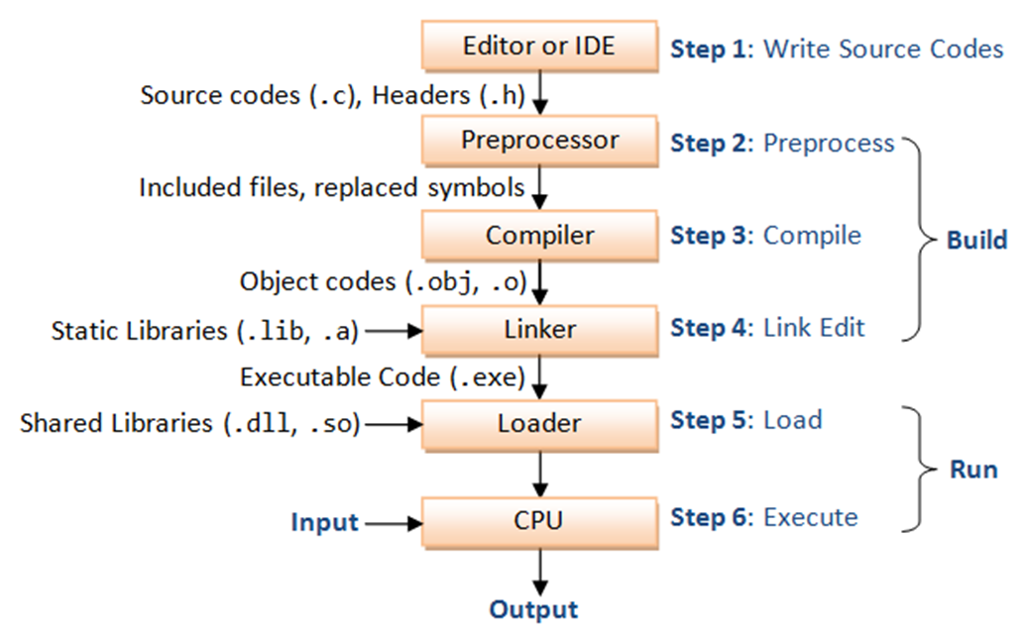
High Level Language
Python 101
A program written in high-level language is called Source-Code.
The process of executing programs written in high level languages as given below:-
Compiler: Used to translate a program written in high level language into equivalent machine code for execution.
Linker: Used to combine the object code and the code is stored in libraries into Machine Language.
Loader: To load, assign the storage space for executable program in the memory to execute.

Slide 7
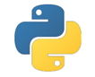
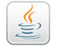
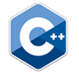
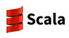
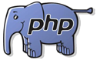

Different Programming Languages
Python 101
Python Java C++ Scala
HTML PHP

Slide 8
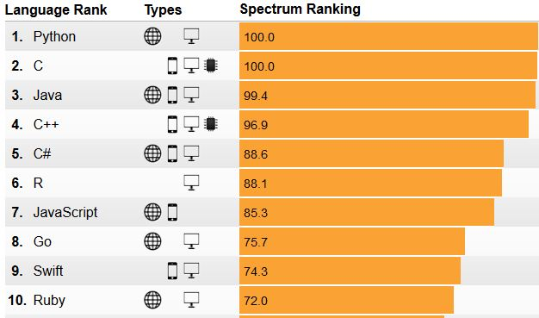
Top Programming Languages
Python 101
Python No.1 Programming languages in the world. Most of the organization’s rewritten the code in python and discarded the other languages like Amazon.

Slide 9

Top No 1 Programming Language - Python
Python 101
Python seems to swallow not only R, but also most other languages, except for SQL, Java, C/C++ which remained at about the same level. R has declined for the first time since we have run this survey. Other languages have also declined.
Here are the main programming languages sorted by popularity.
Python Champion
Pytho65.6% (was 59.0% in 2017), 11% up
Python, 65.6% (was 59.0% in 2017), 11% up
R, 48.5% (was 56.6%), 14% down
SQL, 39.6% (was 39.2%), 1% up
Java, 15.1% (was 15.5%), 3% down
Unix, shell/awk/gawk, 9.2% (was 10.8%), 15% down
Other programming and data languages, 6.9%, (was 7.6%), -9% down
C/C++, 6.8%, (was 7.1%), 3% down.
Scala, 5.9%, (was 8.3%), 29% down
Perl, 1.0% (was 1.9%), 46% down
Julia, 0.7% (was 1.2%), 45% down
Lisp, 0.3% (was 0.4%), -25% down
Clojure, 0.2% (was 0.3%), -38% down
F, # 0.1% (was 0.5%), -73% down

Slide 10
Python Overview

Slide 11

What is Python?
Python 101
Python is high level programming language
Python was developed by Guido Van Rossum in 1989 while working at National Research Institute at Netherlands in 20th Feb 1991
The name “Python” was coined from TV show “The Complete Monty Python’s Circus” which was broadcasted in BBC from 1969 to 1974
Guido developed Python programming language by taking almost all programming features from different languages
Functional programming features from C
Object Oriented programming features from C++
Scripting Language features from Perl and Shell script
Modular programming features from Modula-3

Slide 12

Author of Python
Python 101
Guido Van Rossum - A Dutch programmer, popularly known as the author of Python programming language. He has created Python in 1989 and has worked for Google , Dropbox and currently employed in Microsoft.

Slide 13
Features of Python

Slide 14
Features of Python
Python 101
Simple and easy to learn
Freeware and Open Source
High level programming language
Platform independent
Portability
Dynamically typed
Both Procedure Oriented and Object Oriented
Interpreted
Embedded
Extensible
Rich library collection
Python features a dynamic type system and automatic memory management.
It supports multiple programming paradigms, including object-oriented, imperative, functional and procedural, and has a large and comprehensive standard library.

Slide 15
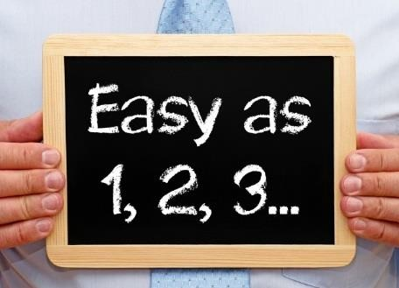
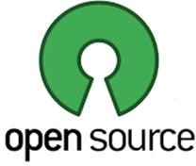
Features of Python
Python 101
1. Simple and easy to learn
Python is very simple and easy to learn, read & write similar to English language.
Syntax are very simple and only 33 keywords are available
While compared to other languages, we can write programs with very less no of lines with indentation. Hence python programs are mor simple and readable
Automatically development time gets reduced and with cost savings in the project
2. Freeware and Open Source
Python is a freeware without any licence we can use directly
Python is a open source code, hence we can customize based on the requirement

Slide 16
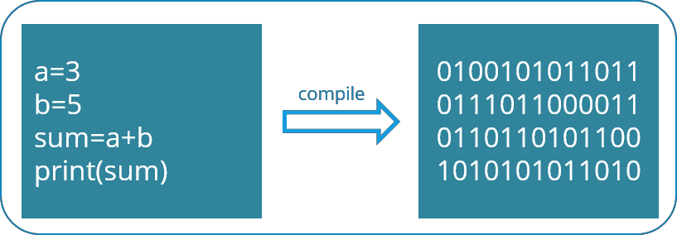
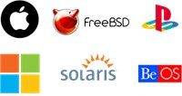
Features of Python
Python 101
3. High Level Programming Language
Python is a high level programming language and we don’t need to worry about the low-level details like memory allocation, security etc. while writing a Python script
4. Platform Independent
Once we write a python program, it can run on any platform without rewriting once again. Internally PVM is responsible to convert in to machine understandable form
5. Portability
Python programs are portable, so we can easily migrate from one platform to another. At the same time it will produce the same results on any platform

Slide 17
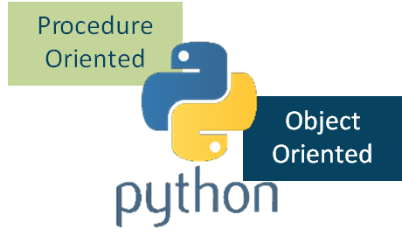
Features of Python
Python 101
6. Dynamically Typed
Hope we remember Java, C are statically typed languages because we have to provide at the beginning only.
Where as in python we are required to declare type for variables. Whenever we are assigning the value, based on value, type will be allocated automatically. Hence python is considered as a dynamically typed language. The dynamic porting nature will provide more flexibility to programmer.
7. Both Procedure Oriented and Object Oriented
Python supports procedure-oriented programming (like Pascal, C) as well as object- oriented programming (Java, C++) features.

Slide 18
Features of Python
Python 101
8. Interpreted
We are not required to compile programs explicitly, so internally python interpreter will take care of compilation. Suppose if the compilation fails interpreter raise syntax errors. Once compilation success then Python Virtual Machine (PVM) is responsible to execute
9. Embedded
We can use Python programs in any other programming languages
10. Extensible
We can use other language programs in python.
The main advantages are:-
We can use already existing legacy non-python code
We can improve performance of the application

Slide 19

Features of Python
Python 101
11. Rich Library Collection
Python has a rich in-built library, programmers can use this library directly and not responsible to implement the functionality

Slide 20
Python Execution

Slide 21
How Python gets Executed?
Python 101
When a programmer tries to run a Python code as a script or instructions in an interactive manner in a Python Shell, then Python performs various operations step by step internally.
Step 1: The Interpreter reads a Python code or instruction from source file with .py extension. Then it verifies that the instruction is well formatted by checking the syntax of each line. Suppose if it encounters any error, it immediately halts the translation and shows an error message.
Step 2: If there is no error, the interpreter translates it into its equivalent form in low level language called “Byte Code”. After successful execution of Python script or code, it is completely translated into byte code.
Step 3: Byte code is sent to the Python Virtual Machine (PVM). Here again the byte code is executed on PVM. If an error occurs during this execution then the execution is halted with an error message.

Slide 22
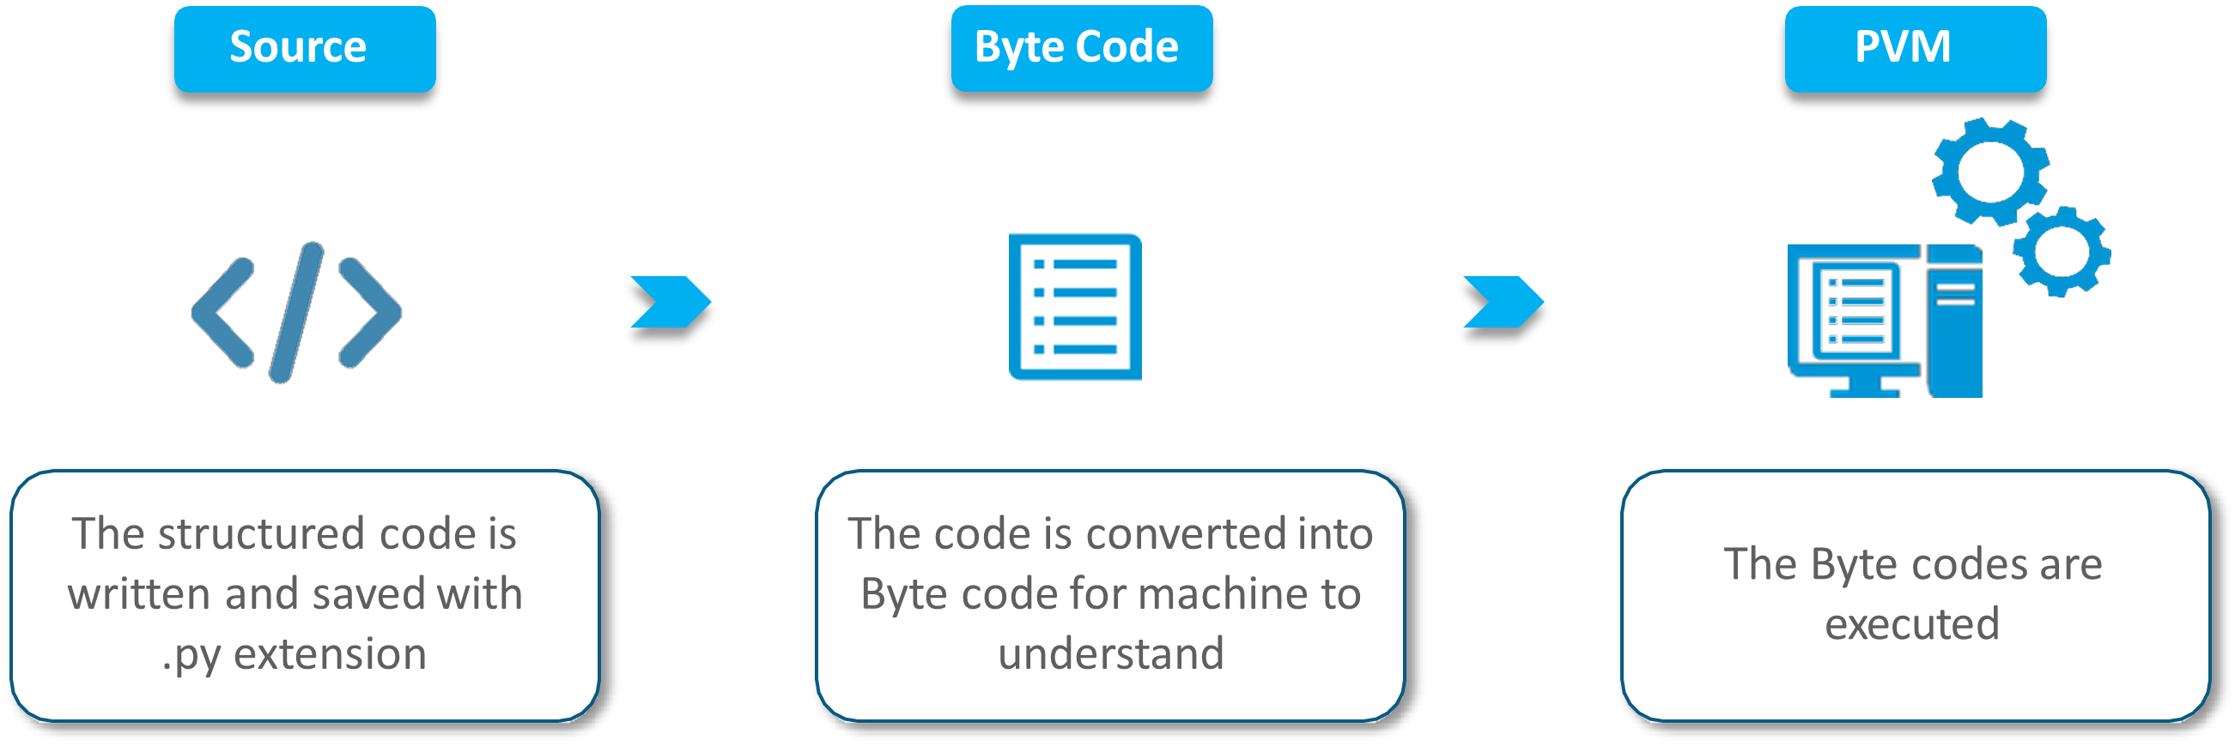
How Python gets Executed?
Python 101

Slide 23
Interesting Facts in Python

Slide 24
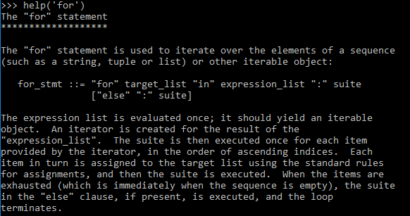
Python is a interpreter language
Python 101
Python Interpreter is a program that reads and executes code
This includes source code, pre-compiled code and scripts
Example: help(‘for’)

Slide 25
Versions of Python
Python 101
Python 1 introduced in Jan 1994
Python 2.0 introduced in Oct 2000
Python 3.0 introduced in Dec 2008
The current version is Python 3.9 and stable version is 3.7
Note
Any new version should provide support for old version program exception in python
Python 3 is not backward compatibility with Python 2.
Python 2 support is not supported after 2020

Slide 26
Where can we use Python?
Python 101
For developing Web, Desktop, Database and Network applications
Web – Web Development, Web Scaping, Testing
For developing Artificial Intelligence, Machine Learning, IoT & Data Analysis applications
Data Analysis using Numpy, Pandas,..
Machine Learning using Scikit,..
Artificial Intelligence using TensorFlow, Caffe, Keras
For developing Games

Slide 27
Who is using Python?
Python 101
Amazon
Microsoft
Google, Youtube
IBM
Yahoo!
Dropbox
Raspberry
Netflix
BitTorrent
NASA
Network Stock Exchange

Slide 28
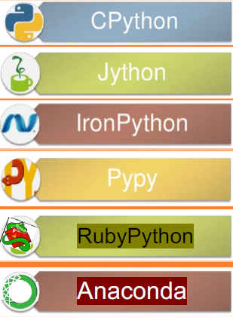
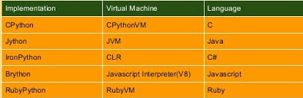
Flavors of Python
Python 101
CPython – Cython – To work with C language applications
JPython – Jython – For Java applications and run on JVM
Iron Python – For .NET platforms
PyPython – Improved performance of JIT compiler available in PVM
RubyPython – For Ruby Platforms
Anaconda – To handle large volume of data processing
Stackless (Python for concurrency)

Slide 29
Is it Python is a Scripting Language?
Python 101
'Yes' A scripting language usually doesn’t need to be compiled to run as you write some meaningful code. Microsoft excel may be built using C++ language but it exposes a scripting language called Visual Basic for Applications, for users to define their custom functionality.
Similarly web browsers may be built with C++/Java language but they expose a scripting language called javascript. A scripting language generally sits behind some programming language. Scripting languages generally have less access to the computer’s native abilities since they only run on a subset of the programming language. Scripting languages may have less access and are slower compared to programming languages, but they can be very powerful programming tools.

Slide 30
Limitations of Python
Python 101
Weak in Mobile Computing
Get slow in speed because python is an interpreter language
Difficult to handle run time errors
Underdeveloped Database Access Layers

Slide 31
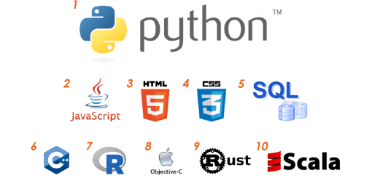
Top 10 Reasons to learn Python

Slide 32
Top 10 Reason to learn Python
Python 101
Python’s popularity & high salary
Python is used in Data Science
Python’s scripting & automation
Python used with Big Data
Python supports Testing
Computer Graphics in Python
Python used in Artificial Intelligence
Python in Web Development
Python is portable & extensible
Python is simple & easy to learn

Slide 33
Why Python is the ultimate choice for Data Science?

Slide 34
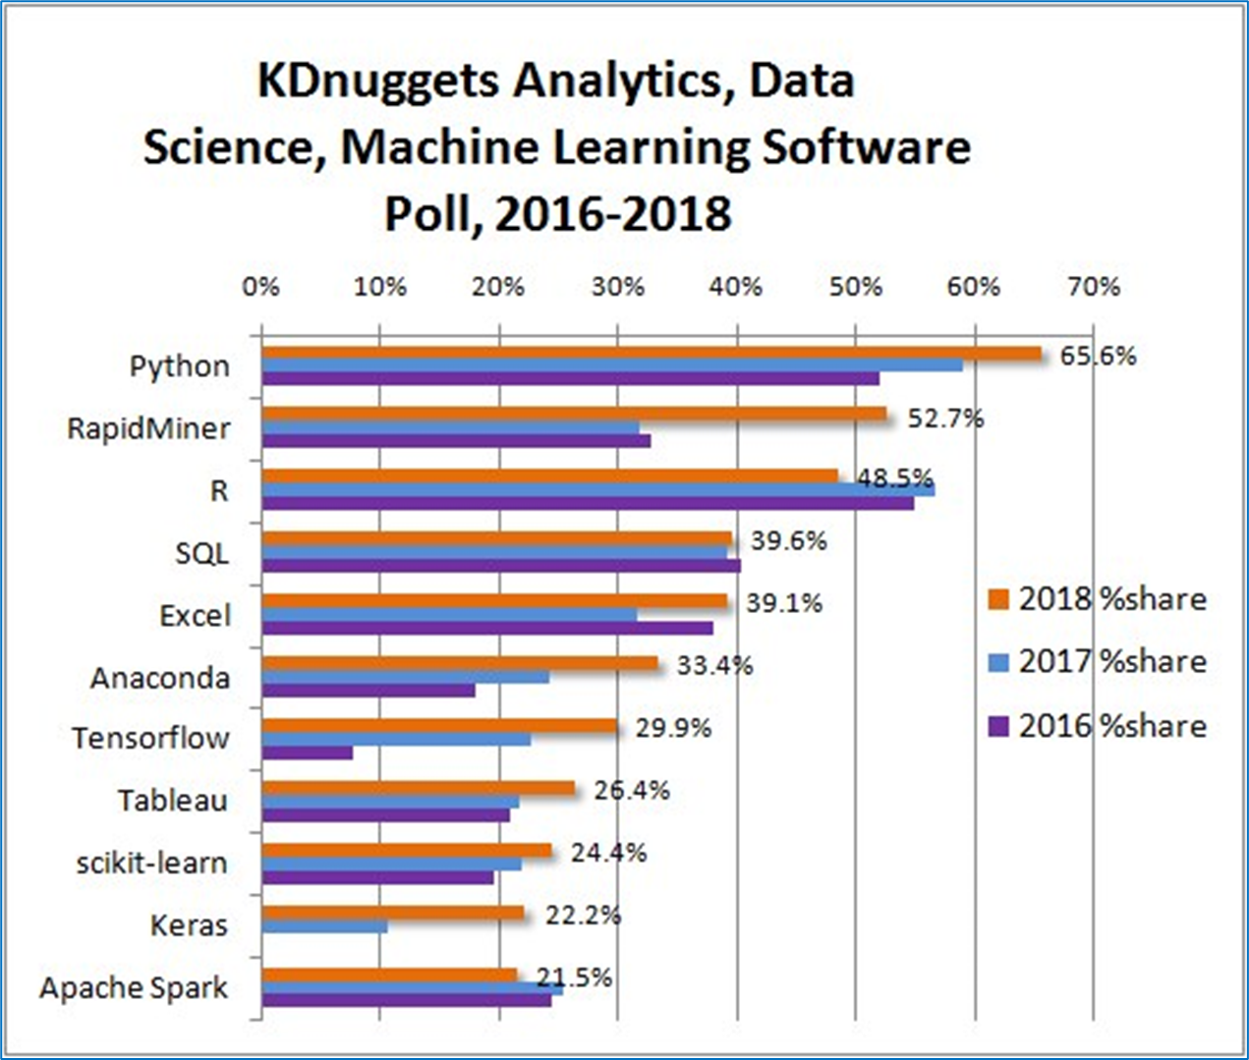
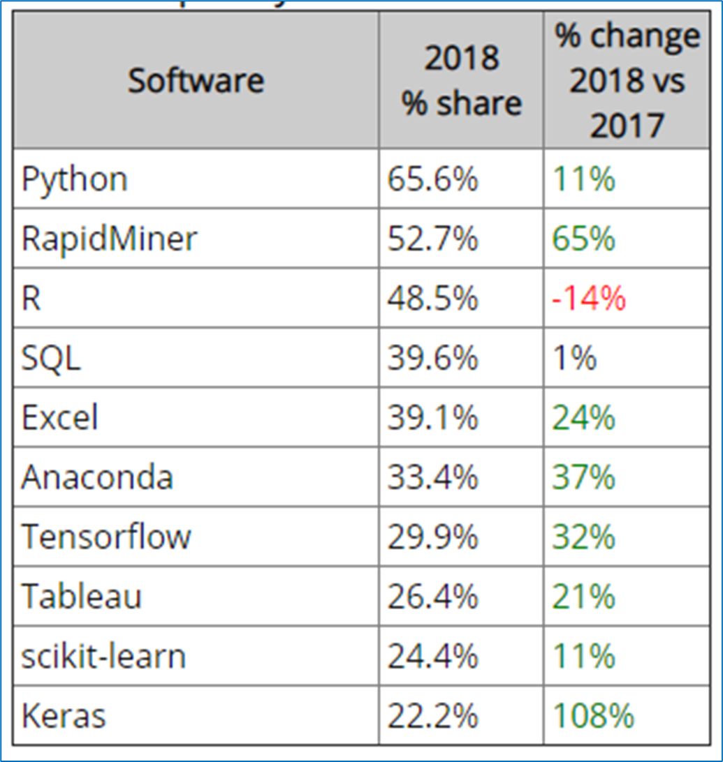
Python is the ultimate choice for Data Science
Python 101
Top Analytics/Data Science/ML Software in 2018 KDnuggets Poll

Slide 35
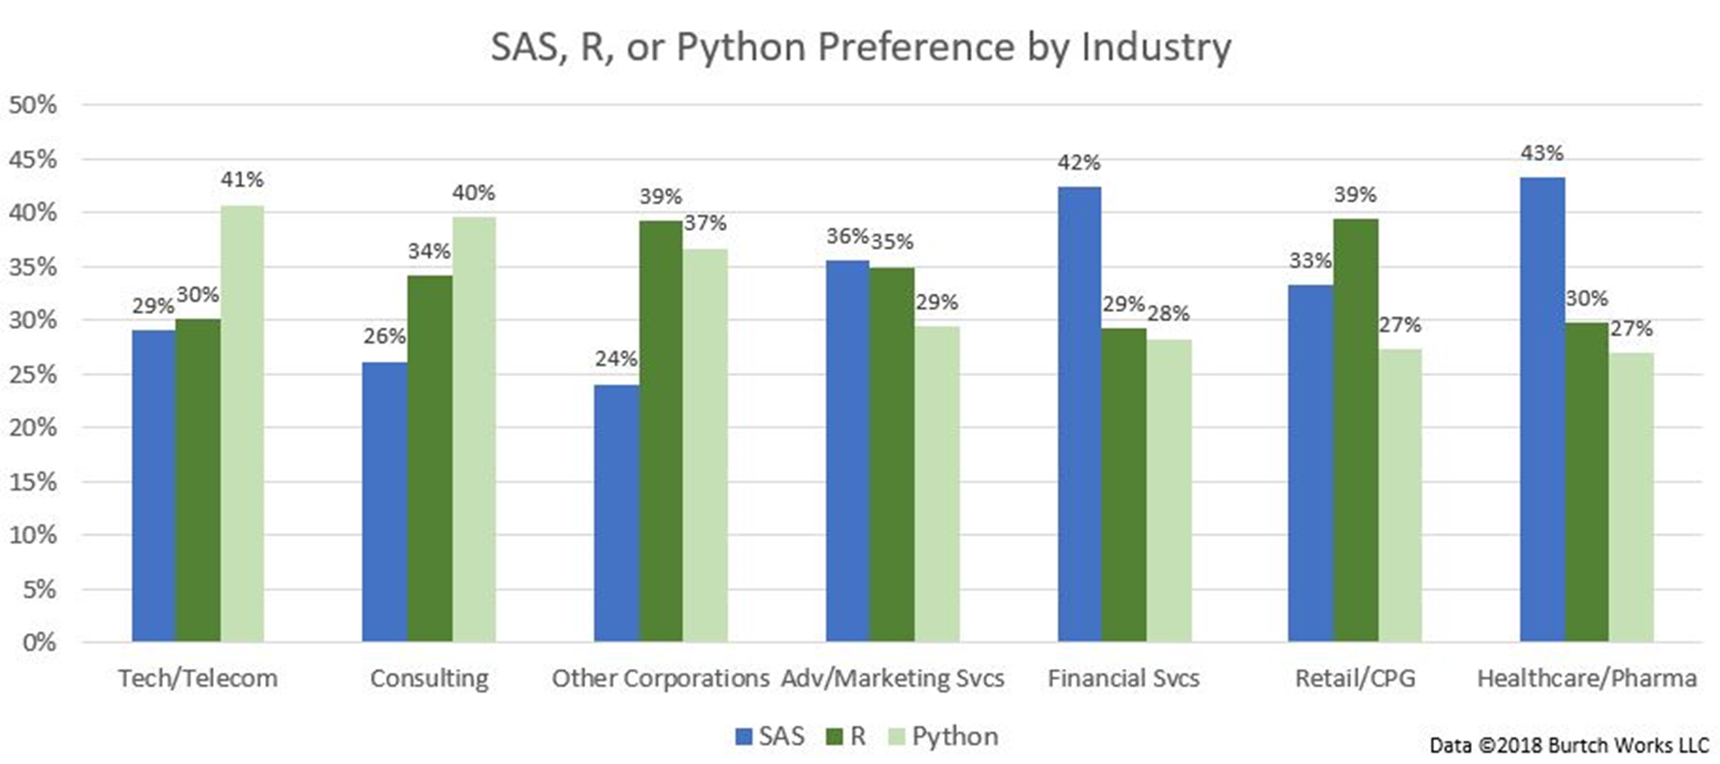
SAS, R, Python Comparison
Python 101
Ref: https://www.kdnuggets.com/2018/05/poll-tools-analytics-data-science-machine-learning-results.html

Slide 36
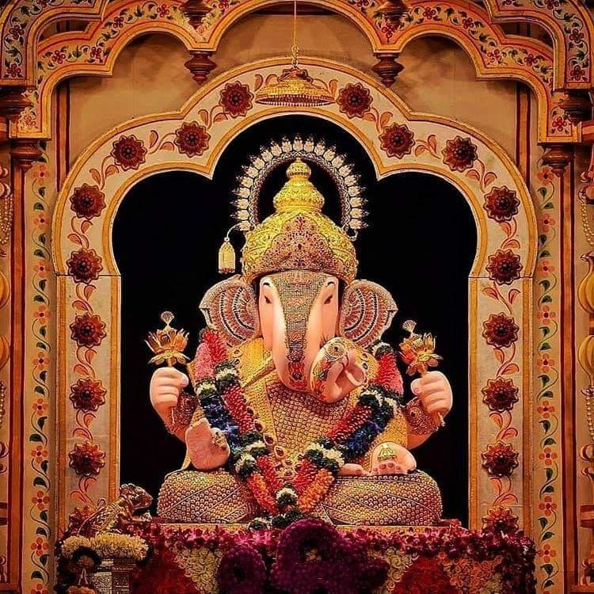

T h a n k Y o u !
I n t e l l e c t S r i r a m
Subscribed
LinkedIn : https://www.linkedin.com/in/sriram-balasubramanian-374566166/
GitHub : https://github.com/intellectsriram

